Slide 1



Custom Pega Training for Ministry of Justice
Entry Level – 3 Day App Build

Slide 2
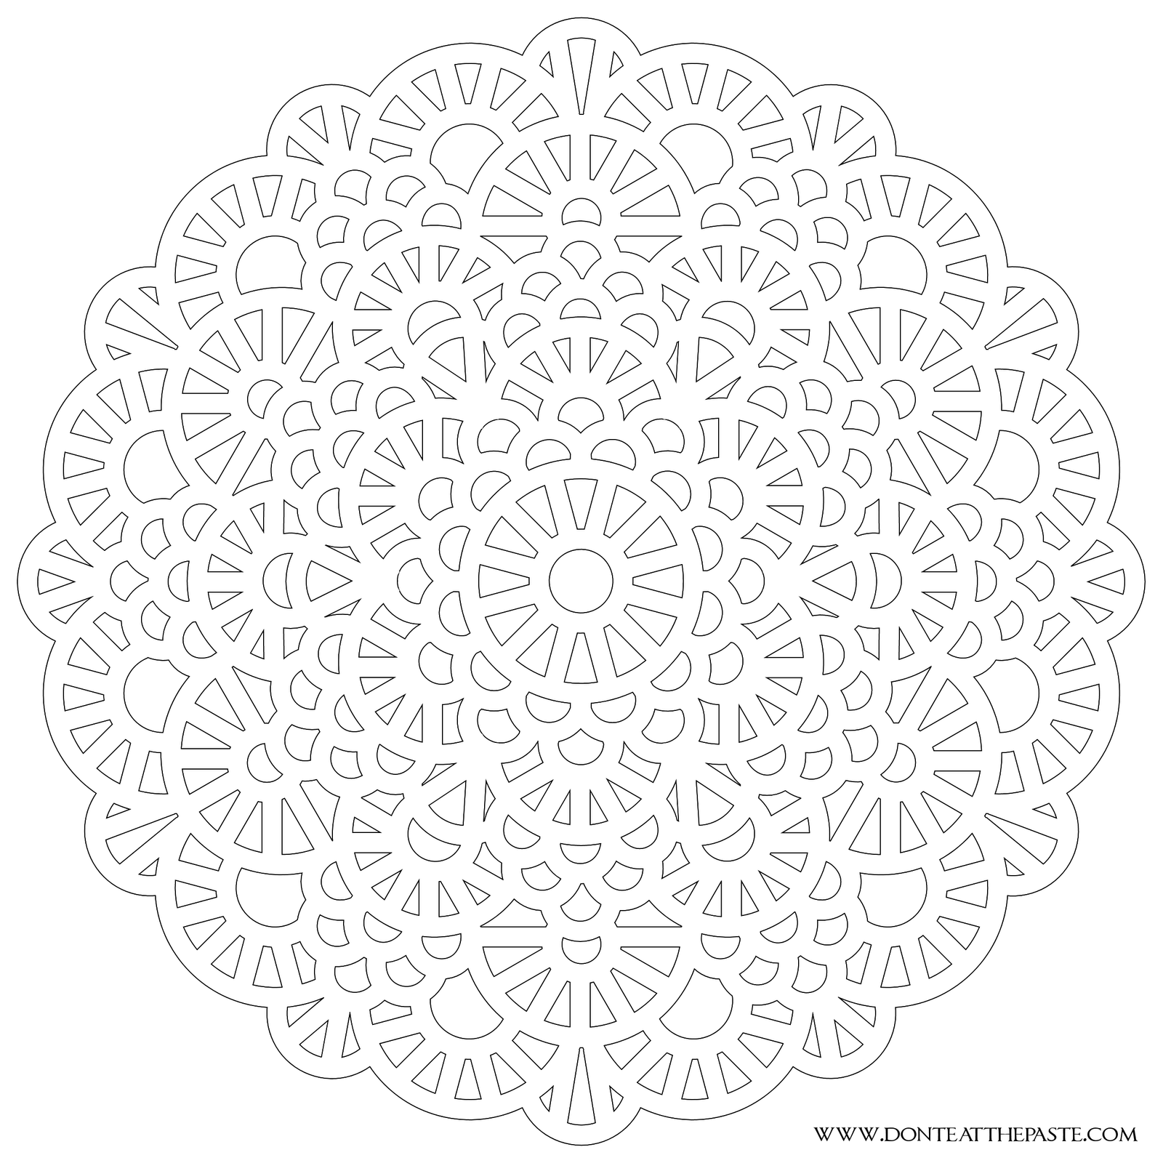


Pega Inception to app build in a day
Day 2

Slide 3


Day 2- Agenda & Introductions
Time | Topics
9:30 AM to 12:30 AM | INTRODUCTION TO CONFIGURING A USER FORM, USER PORTAL, STYLING THE UI AND LOCALIZATION
12:30 PM – 1:30 PM | LUNCH BREAK
1:30 PM – 3:00 PM | INTRODUCTION TO VALIDATING CASE DATA
3:00 PM – 3:30 PM | COFFEE BREAK
3:30PM – 5:30PM | ACTIVITES, DATA TRANSFORM,DECISION RULES AND DATA PAGES
5:30PM – 6:00PM | Q&A

Slide 4
9:30 AM – 10:30 AM
INTRODUCTION TO CONFIGURING
A USER FORM
USER PORTAL
STYLING THE UI AND LOCALIZATION

Slide 5
INTRODUCTION TO CONFIGURING A USER FORM
Good user interface (UI) design considers the impact of device size and how users interact with their devices.
Consider an application with a screen resolution fixed to accommodate a tablet device. Users with tablets can easily use the application.
Users accessing the application with laptops might find the screen resolution too small to read.
Users with mobile phones might not be able to use the application. Effective UI accounts for all of these interactions.

Slide 6
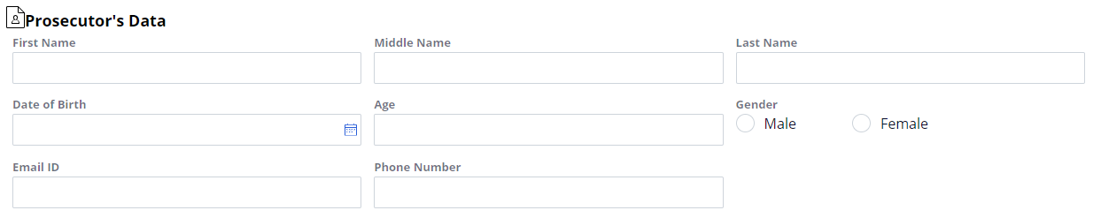

SECTION RULES
In Pega, you build user forms with ”sections”. Sections group information and functionality by context and purpose.
Inside a section, you organize UI elements with ”layouts”.
Layouts contain rows and columns, defining a set of ”cells”.
A cell can be empty or contain various fields and controls.

Slide 7

INTRODUCTION TO CUSTOMIZING A USER PORTAL
User portals provide application users with the tools and options needed to work with a Pega application. Each portal is tailored to a specific user role. You learn how to customize a portal for application users.

Slide 8
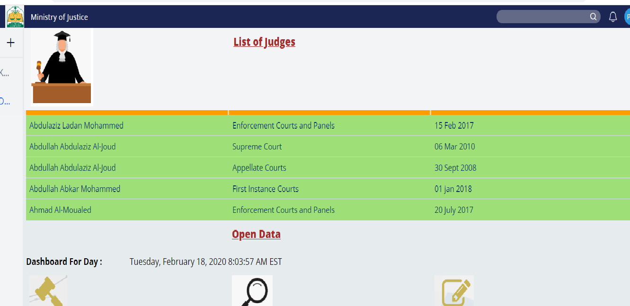

User Portal
Applications often support multiple types of users, such as case workers and managers.
Each type of user interacts with the application in a unique manner. For example, case workers create and process cases, while managers track the progress of cases.
Each type of user needs access to tools and features that support their role in case processing.

Slide 9

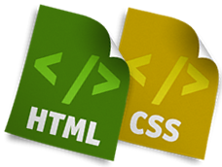
INTRODUCING THE STYLING CONCEPT
A web application is made up of content and presentation. We spoke about content earlier, so now we will switch gears and discuss presentation.
In modern web applications there is a clear separation between content and presentation. Content is the information provided by the application or webpage, and presentation refers to how the information is presented to users.

Slide 10

Skin Rule
The presentation layer consists of skin rules that specify the presentation of the content, including typography, borders, backgrounds, layouts, and UI placement and alignment.
A Skin rule is comprised of mixins and component style formats.
A mixin is a style pattern that defines typography, border, or background, or a combination of these. It can be reused to create other mixins and style formats.
A style format is a group of styling attributes that provides presentation style for components, such as dynamic layouts, or controls, such as buttons and links.

Slide 11
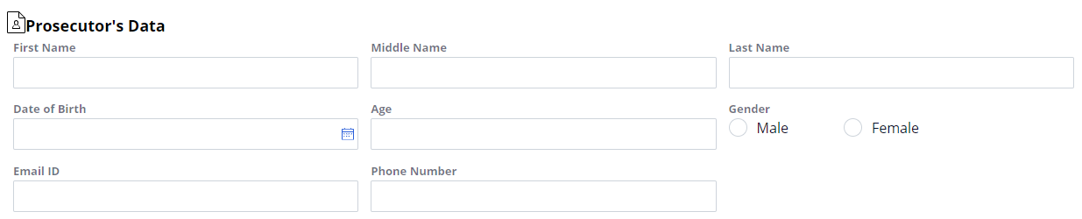
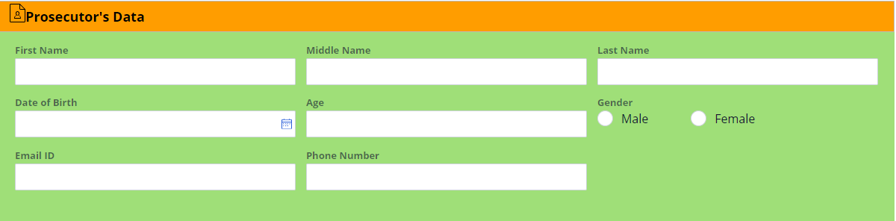

Before changing Skin rule:
After changing Skin rule:

Slide 12

INTRODUCTION TO SUPPORTING MULTIPLE LANGUAGES IN APPLICATION
Pega applications can be configured to meet localization needs for work in different languages and time zones.
Localization is the process of adapting internationalized software for a specific region or language by adding locale-specific components and translating text.
For example, if a company is multinational, it likely maintains offices in multiple countries.

Slide 13
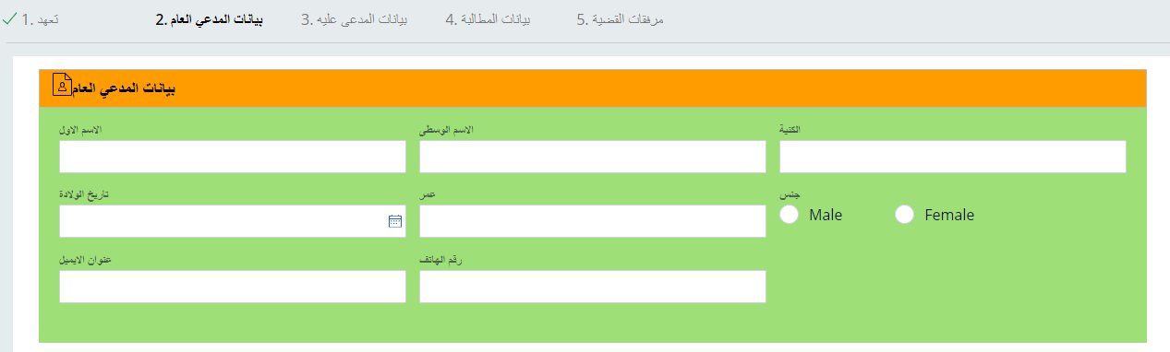
Designing an application for localization
Pega Platform provides a Localization wizard that automates many of the steps necessary to create language-specific versions of your application.
After running the Localization wizard the form will look this:

Slide 14
12:30AM – 1:30PM LUNCH BREAK 1:30AM – 3:00PM INTRODUCTION TO VALIDATING CASE DATA

Slide 15
1:30AM – 3:00PM INTRODUCTION TO VALIDATING CASE DATA

Slide 16

VALIDATING CASE DATA
When you design a user form, you add all the fields and controls required by a design specification.
However, users must enter data that uses a format or contains a value that the system can process correctly.
Pega provides rules that validate the data and help prevent processing errors when a form is submitted.

Slide 17
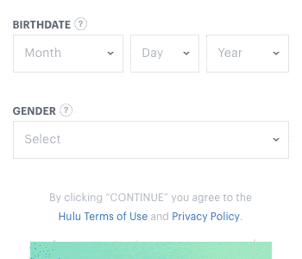
Validation rule
There are two types of validation rules:
1) Validate
2) Edit validate.
Validate rules: You use validate rules to compare a property against a condition when the user submits a form.
For example, assume your view contains a field for date of birth, you can design a validate rule to display an error if the user submits a date that is in the future.
Edit Validate rules: You use edit validate rules with single value, value list, and value group properties to test for patterns.
For example, an email address can reference an edit rule to test whether the entered value contains an "at" (@) symbol.

Slide 18
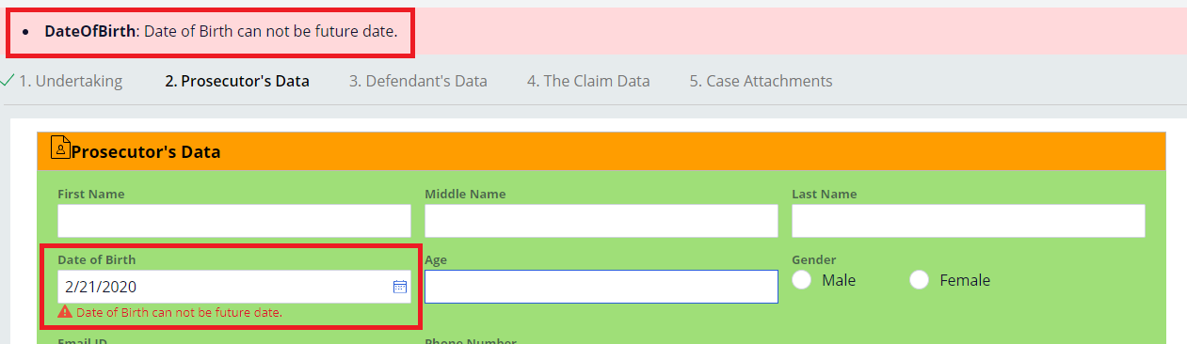
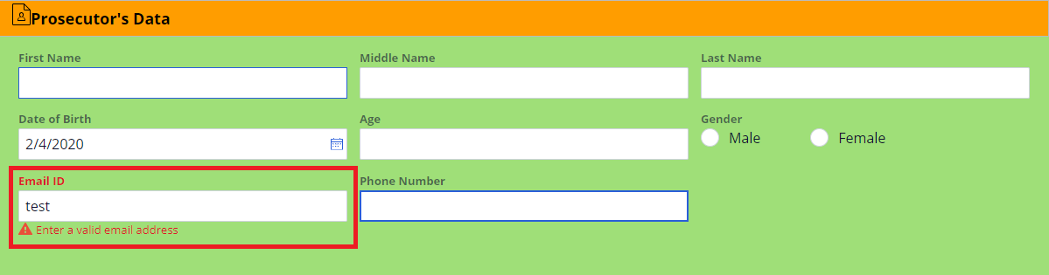
Validate Rule:
Edit Validate Rue:

Slide 19
3:00 PM – 3:30 PM COFFEE BREAK 3:30PM – 5:30PM ACTIVITES, DATA TRANSFORM
DECISION RULES AND DATA PAGES

Slide 20
12:30AM – 1:30PM LUNCH BREAK 1:30AM – 3:00PM BUILD PART 1- PEGA CASE MANAGEMENT, SLA,UI

Slide 21
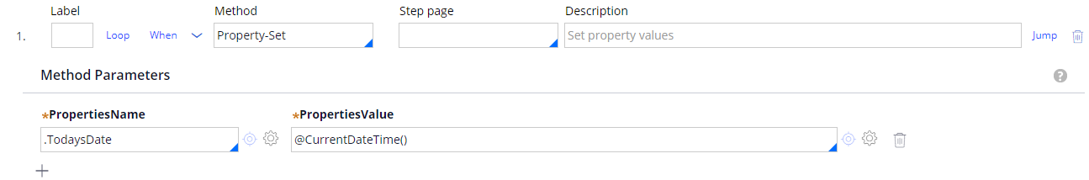
Activity Rules
Activity rules are one way to automate the processing of work by using a procedural, program-like approach, without requiring Java skills or manually entering java code.
An activity is presented as a series of steps, with some of the features of an object-oriented programming language, such as iterations and conditions.
Each Activity step must specify a method that describes the action the system takes.
For Example: The property-set method sets the value of a specified property.
A step page is the page in memory on which the method is processed. By Default, the activity executes within the context by which it was called.

Slide 22
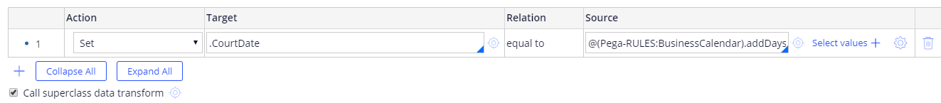
Data Transforms
It is basically mapping data or process data in some target page. The source can be of any page data or just some hard coded values.
It belongs to data model category.
There may be some situation, where you need to update the data in the clipboard. For this Pega provides us a rules called “Data Transformed”.

Slide 23
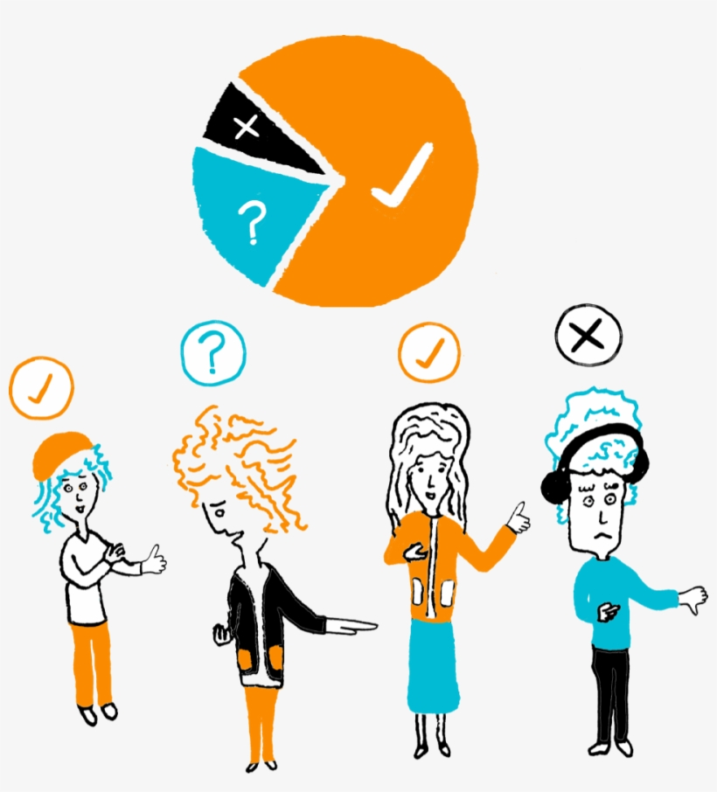
DECISION RULES
Decision tables and decision trees are fundamental to enforcing business decisions.
You can use these decision rules in flows, routers, activities, and declare expressions.
For example, a decision rule can automatically select a connector to advance a case.
Decision tables and decision trees allow you to design complex decision logic that goes far beyond simple yes/no decisioning.

Slide 24
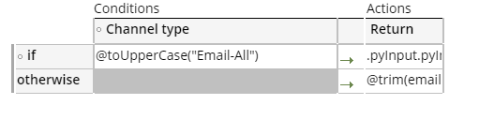
Decision Table
Decision tables are a good approach when you use a set of properties or expressions to arrive at a decision.
In the following example, a banking application uses a decision table for determining monthly maintenance fees. To find the correct fee, the decision table compares the account type and customer type property values on the table to the input values.

Slide 25
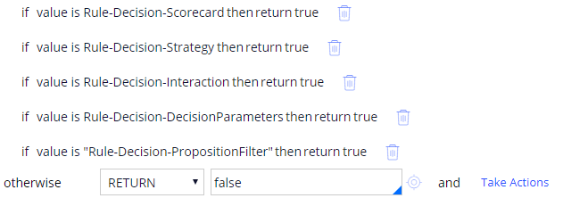
Decision Tree
As an alternative to decision tables, you can use decision trees to handle logic that calculates a value from a set of test conditions.
Both decision tables and decision trees evaluate properties or conditions.
For decision trees, a true comparison can lead to additional comparisons (if... then... else logic).

Slide 26
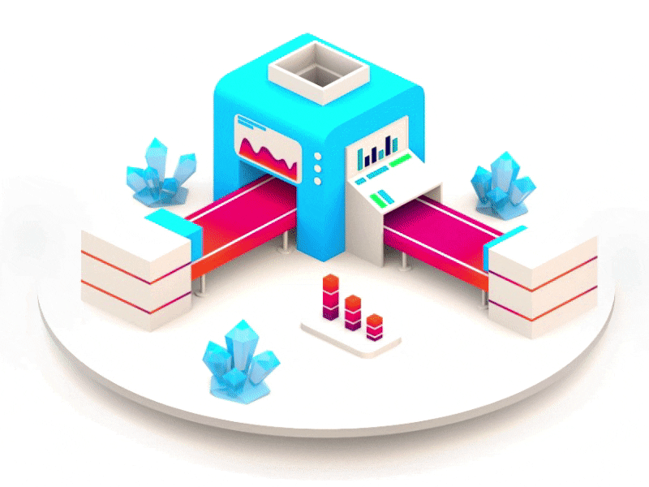
Data Pages
You use data pages to retrieve data for your application, regardless of the source.
Data pages cache data on demand to a clipboard page and define who can access the data page.
When working in Dev Studio, you can create data views, also known as data pages.
In App Studio, you can view a list of data views associated with a data type.
A data Page can conditionally source from multiple sources.

Slide 27
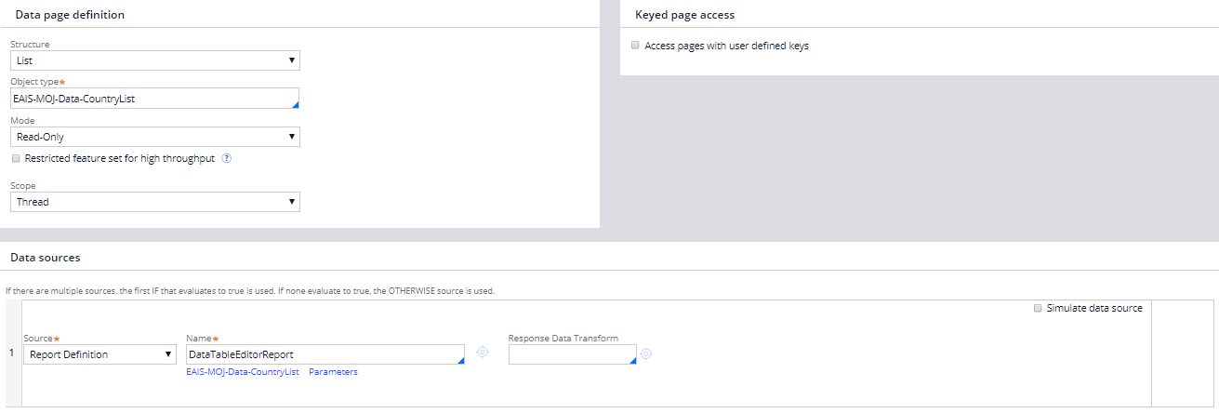

Slide 28
5:30PM – 6:00PM
Q&A

Slide 29
Thank you
Any Questions?

